Slide 1

Fundamental of Accounting
Jahangir Tanveer
Lecture 4

Slide 2

Adjusting the Accounts

Slide 3
1 Explain the time period assumption.
2 Explain the accrual basis of accounting.
3 Explain the reasons for adjusting entries.
4 Identify the major types of adjusting entries.
5 Prepare adjusting entries for deferrals.
6 Prepare adjusting entries for accruals.
7 Describe the nature and purpose of an adjusted trial balance.

Slide 4
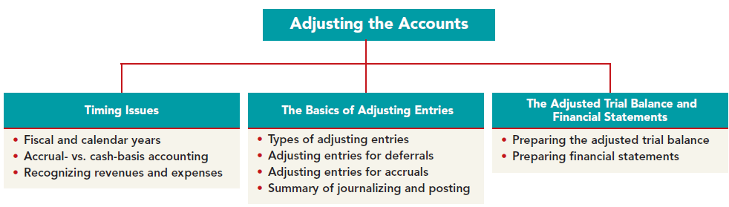

Slide 5
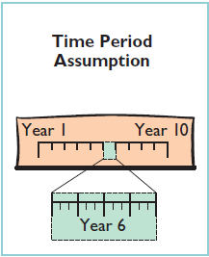
Accountants divide the economic life of a business into artificial time periods.
This convenient assumption is referred to as the time period assumption.

Slide 6
Fiscal and Calendar Years
Both small and large companies prepare financial statements periodically in order to assess their financial condition and results of operations. Accounting time periods are generally a month, a quarter, or a year. Monthly and quarterly time periods are called interim periods. Most large companies must prepare both quarterly and annual financial statements.
An accounting time period that is one year in length is a fiscal year. A fiscal year usually begins with the first day of a month and ends twelve months later on the last day of a month.
Most businesses use the calendar year (January 1 to December 31) as their accounting period.

Slide 7
Accrual- vs. Cash-Basis Accounting
Under the accrual basis, companies record transactions that change a company’s financial statements in the periods in which the events occur.
Under cash-basis accounting, companies record revenue when they receive cash. They record an expense when they pay out cash.

Slide 8
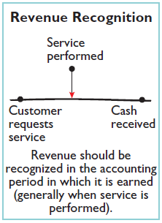
Recognizing Revenues and Expenses
REVENUE RECOGNITION PRINCIPLE
The revenue recognition principle dictates that companies recognize revenue in the accounting period in which it is earned.

Slide 9
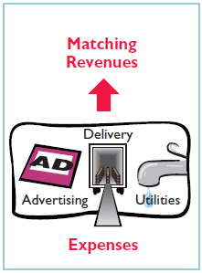
Recognizing Revenues and Expenses
MATCHING PRINCIPLE
Accountants follow a simple rule in recognizing expenses: “Let the expenses follow the revenues.” That is, expense recognition is tied to revenue recognition.

Slide 10
The trial balance—the first summarization of the transaction data—may not contain up-to-date and complete data. This is true for several reasons:
1. Some events are not recorded daily because it is not efficient to do so. For example, companies do not record the daily use of supplies or the earning of wages by employees.
2. Some costs are not recorded during the accounting period because they expire with the passage of time rather than as a result of daily transactions. Examples are rent, insurance, and charges related to the use of equipment.
3. Some items may be unrecorded. An example is a utility bill that the company will not receive until the next accounting period.

Slide 11
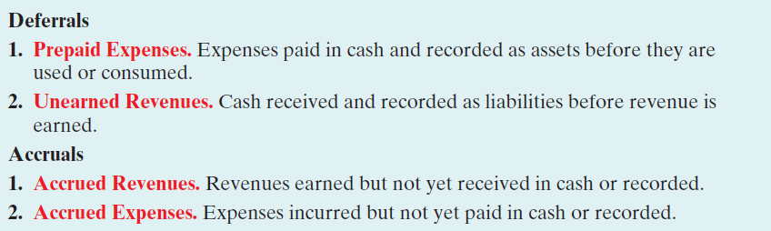
Types of Adjusting Entries

Slide 12
Adjusting Entries for Deferrals
Deferrals are either prepaid expenses or unearned revenues. Companies make adjustments for deferrals to record the portion of the deferral that represents the expense incurred or the revenue earned in the current period.

Slide 13
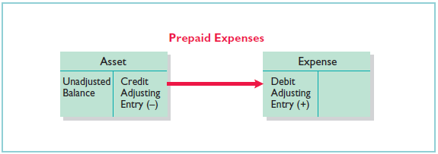
PREPAID EXPENSES
Prepaid expenses are costs that expire either with the passage of time (e.g., rent and insurance) or through use (e.g., supplies)

Slide 14
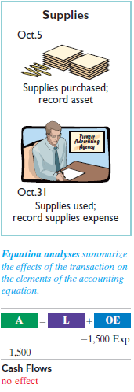

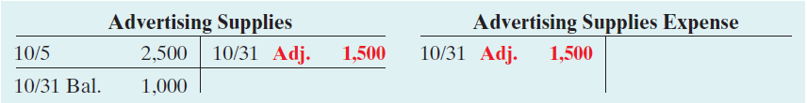
Supplies
Pioneer Advertising Agency purchased advertising supplies costing $2,500 on October 5. Pioneer recorded that transaction by increasing (debiting) the asset Advertising Supplies. This account shows a balance of $2,500 in the October 31 trial balance. An inventory count at the close of business on October 31 reveals that $1,000 of supplies are still on hand. Thus, the cost of supplies used is $1,500 ($2,500 $1,000). Pioneer makes the following adjusting entry.

Slide 15
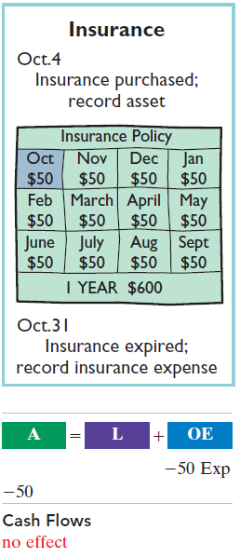
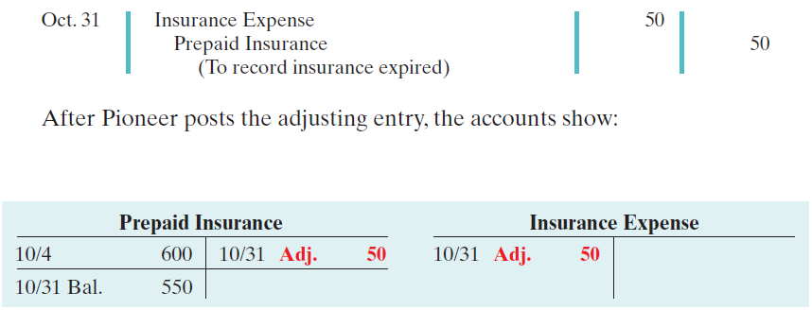
Insurance
On October 4, Pioneer Advertising Agency paid $600 for a one-year fire insurance policy. Coverage began on October 1. Pioneer recorded the payment by increasing (debiting) Prepaid Insurance. This account shows a balance of $600 in the October 31 trial balance. Insurance of $50 ($600 12) expires each month. Thus, Pioneer makes the following adjusting entry.

Slide 16
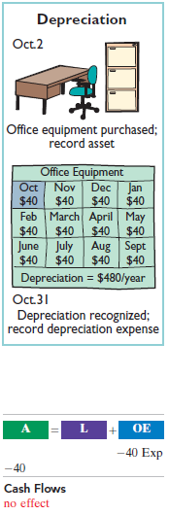
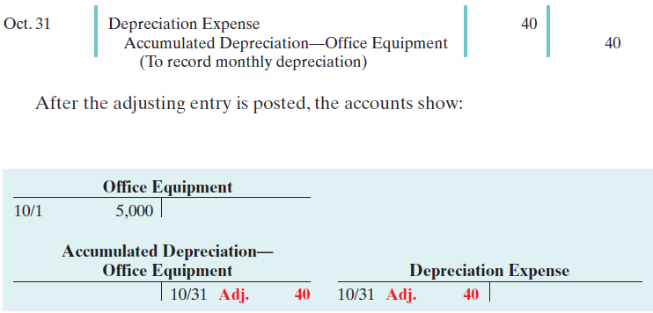
Depreciation
Pioneer Advertising estimates depreciation on the office equipment to be $480 a year, or $40 per month. Thus, Pioneer makes the following adjusting entry to record depreciation for October.

Slide 17
Balance sheet presentation of accumulated depreciation

Slide 18
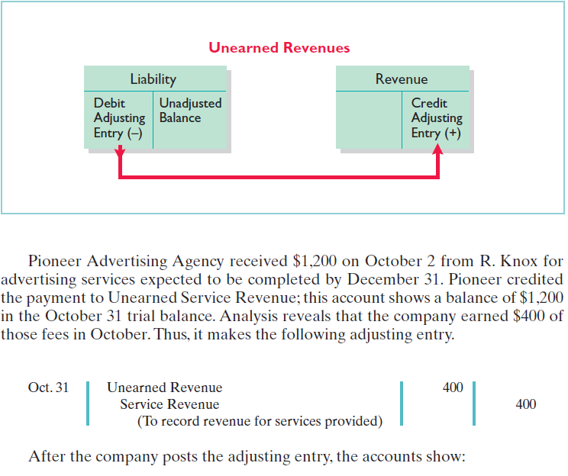
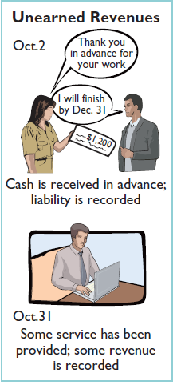
UNEARNED REVENUES

Slide 19
Adjusting Entries for Accruals
The second category of adjusting entries is accruals. Prior to an accrual adjustment, the revenue account (and the related asset account) or the expense account (and the related liability account) are understated. Thus, the adjusting entry for accruals will increase both a balance sheet and an income statement account.

Slide 20
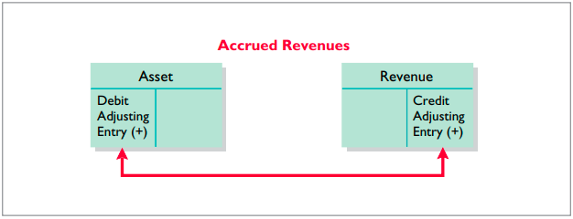
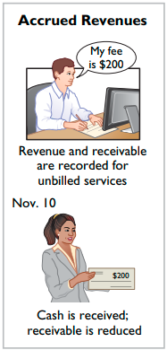

Accrued Revenues
In October, Pioneer Advertising performed services worth $200 that were not billed to clients on or before October 31. Because these services were not billed, they were not recorded. The accrual of unrecorded service revenue increases an asset account, Accounts Receivable. It also increases owner’s equity by increasing a revenue account, Service Revenue

Slide 21
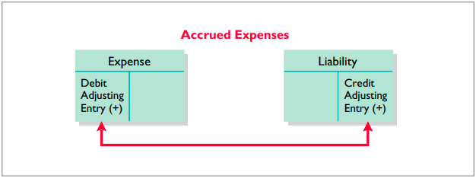
Accrued Expenses
Expenses incurred but not yet paid or recorded at the statement date are called accrued expenses. Interest, taxes, and salaries are common examples of accrued expenses

Slide 22
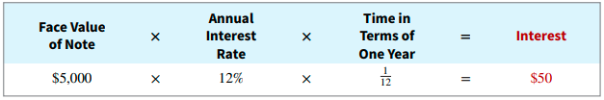

Accrued Interest
Pioneer Advertising signed a three-month note payable in the amount of $5,000 on October 1. The note requires Pioneer to pay interest at an annual rate of 12%.
The amount of the interest recorded is determined by three factors: (1) the face value of the note; (2) the interest rate, which is always expressed as an annual rate; and (3) the length of time the note is outstanding. For Pioneer, the total interest due on the $5,000 note at its maturity date three months in the future is $150 ($5,000 × 12% × 3 12), or $50 for one month.

Slide 23
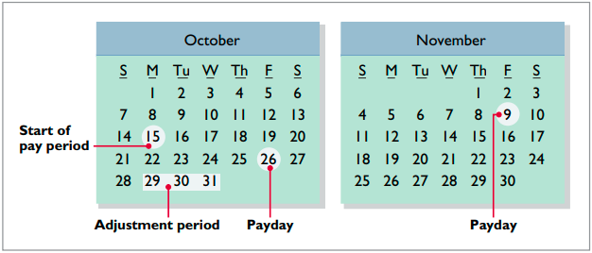
Accrued Salaries and Wages
Companies pay for some types of expenses, such as employee salaries and wages, after the services have been performed. Pioneer Advertising paid salaries and wages on October 26 for its employees’ fi rst two weeks of work. The next payment of salaries will not occur until November 9.

Slide 24

Accrued Salaries and Wages
At October 31, the salaries and wages for these three days represent an accrued expense and a related liability to Pioneer. The employees receive total salaries and wages of $2,000 for a fi ve-day work week, or $400 per day. Thus, accrued salaries and wages at October 31 are $1,200 ($400 × 3). This accrual increases a liability, Salaries and Wages Payable. It also decreases owner’s equity by increasing an expense account, Salaries and Wages Expense,

Slide 25
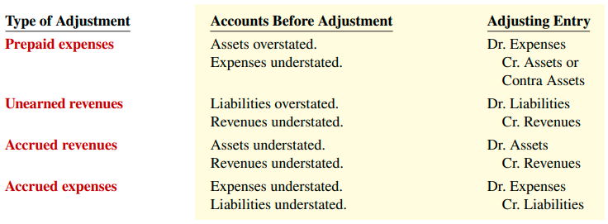
Summary of Basic Relationships

Slide 26
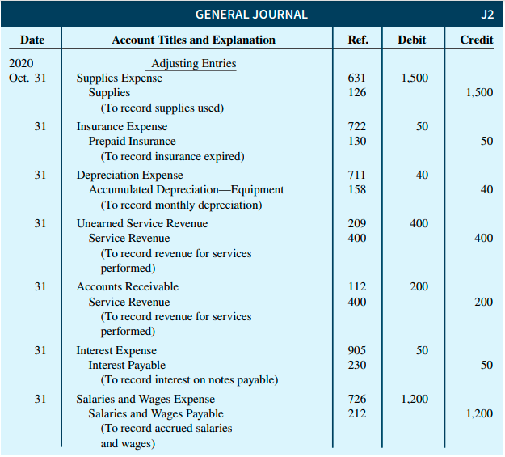

Slide 27
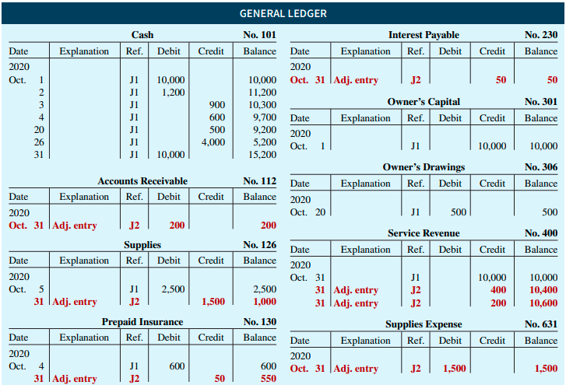

Slide 28
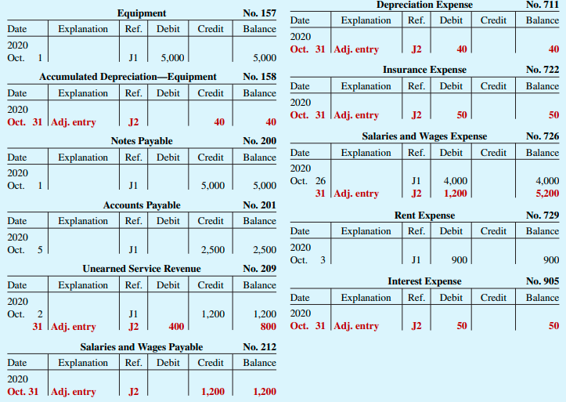

Slide 29
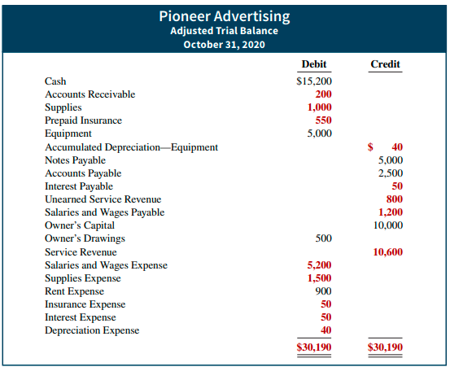
Preparing the Adjusted Trial Balance

Slide 30
